Slide 1
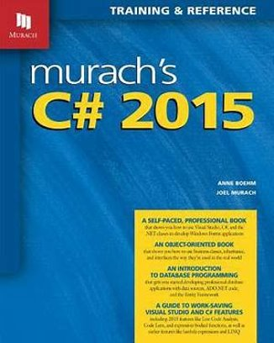
Programming
Chapter 14
Object Oriented Programming

Slide 2
topics
Introduction to OOP
Class & objects
Constructor
Destructor
UML Class diagram (basic)

Slide 3

What is Object-Oriented Programming?
A programming paradigm that focuses on objects
What is an object?
Entity with unique identity that encapsulate state
Light
Turn on
Is light on?
Turn off

Slide 4
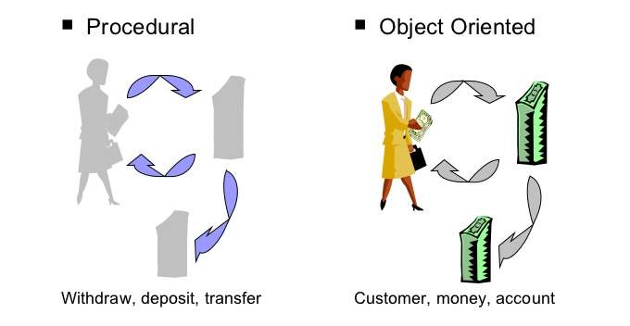
Object-Oriented vs Procedural
Procedural programming starts with features (functions) and how these features can be linked together
OOP starts with objects and how they communicate

Slide 5
Object-Oriented vs Procedural
Procedural Oriented Programming | Object Oriented Programming
Program is divided into small part call functions | Program is divided into parts call objects
POP does not have any proper way for hiding data so it is less secure | OOP provides Data Hiding so provides more security
Example of POP are: C, VB, FORTRAN, Pascal | Example of OOP are: C++, JAVA, VB.NET, C#.NET

Slide 6
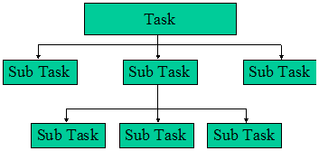
Object-Oriented vs Procedural
Procedural programming is top-down
OOP is bottom-up

Slide 7

Class
A class is an abstraction of similar objects
A class can be seen as an abstract data type
but it’s much more than that
A class consists of
Class name
Attributes
Methods
Light
Turn on
Is light on?
Turn off
LightBulb

Slide 8
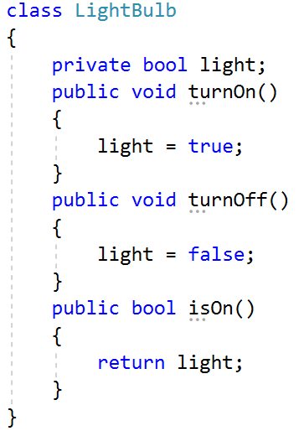
Class declaration in C#
Name of class
Attribute
protection
Methods

Slide 9


Naming Classes
Use PascalCase naming
Use descriptive nouns
Avoid abbreviations (except widely known, e.g. URL, HTTP, etc.)
class Dice { … }
class BankAccount { … }
class IntegerCalculator { … }
class TPMF { … }
class bankaccount { … }
class intcalc { … }

Slide 10
Accessibility Example
…
Service obj = new Service();
obj.memberOne = 10;
obj.memberTwo = 20;
obj.doOne();
obj.doTwo();
…
class Service { public int memberOne; private int memberTwo;
public void doOne() {
…
} private void doTwo() {
…
}
}
Client
Service
Notes:
This is a simple example of public and private modifiers. See how the client can access the public data member and method.

Slide 11
Guideline for Visibility Modifiers
Guidelines in determining the visibility of data members and methods:
Declare the class and instance variables private.
Declare the class and instance methods private if they are used only by the other methods in the same class.
Declare the class constants public if you want to make their values directly readable by the client programs. If the class constants are used for internal purposes only, then declare them private.

Slide 12
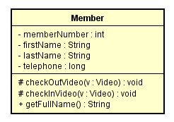
Class notation in class diagram
Class name
private
Attributes
protected
public
Methods
Notes:
Example here

Slide 13
Class Members
Class is made up of state and behavior
Properties store state
Methods describe behaviour
class Dice
{
public int Sides { get; set; }
public string Type { get; set; }
public void Roll() { }
}
Properties
Method

Slide 14
Creating an Object
A class can have many instances (objects)
class Program
{
public static void Main()
{
Dice diceD6 = new Dice();
Dice diceD8 = new Dice();
}
}
Use the new keyword
Variable stores a reference

Slide 15
Properties
Describe the characteristics of a given class
The getter provides access to the field
class Student
{
public string FirstName { get; set; }
public string LastName { get; set; }
public int Age { get; set; }
}
The setter provides field change

Slide 16
Scope of class
Scope of class are variables and functions declared in a class
Scope of class defines scope of objects
A public member (attribute or method) can be accessed from outside the class
A private member restrict accesses from outside the class
A protected member restrict accesses from outside the class

Slide 17
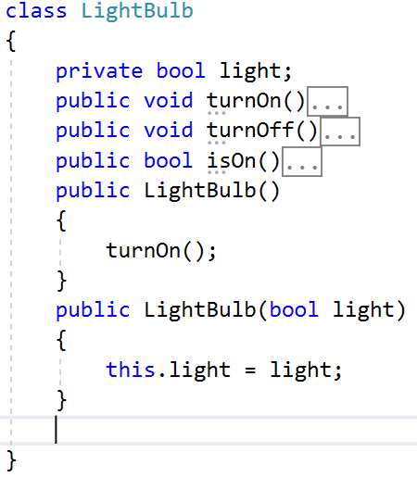
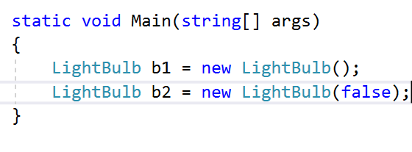
Constructor
Constructor is a special member function of a class that is executed whenever we create new objects of that class.
Constructor has exact same name as the class, no return type and must be public
Why do we need constructor?
Constructors can be very useful for setting initial values for certain member variables.
Constructors can be used for allocate memory for objects

Slide 18
Constructor
LightBulb::LightBulb()
{
light = false;
}
LightBulb::LightBulb(bool l = false)
{
light = l;
}
Default constructor
It’s constructor without parameters
If there is no constructor, compiler will generate a default constructor
Must have default constructor in some cases
Parameterized constructor
Initiate member variables
Can have default values
May be ambiguous with default constructor
LightBulb b = new LightBulb();

Slide 19
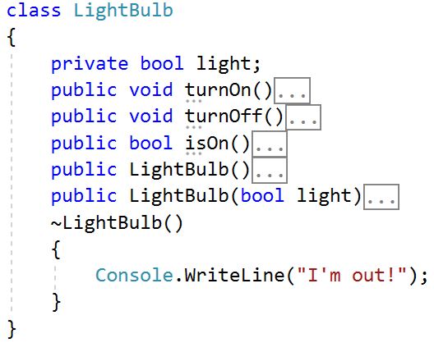
Destructor
Destructor is called when object is removed from memory
Destructor has no parameter, must be public, no return
If not defined, compiler will generate a default constructor
Why do we need destructor?
Deallocate memory
Close files
Close connections (socket, database server, etc.)

Slide 20
Information Hiding and Visibility Modifiers
The modifiers public and private designate the accessibility of data members and methods.
If a class component (data member or method) is declared private, client classes cannot access it.
If a class component is declared public, client classes can access it.
Internal details of a class are declared private and hidden from the clients. This is information hiding.
Notes:
The visibility modifiers dictate the accessibility of class components by the clients. Anything that is considered as internal details should be declared as private and hidden from the clients. For example, exactly how a MobileRobot moves is an internal detail. All the client cares is that a mobile robot is set in motion when its method move is called.
Public methods of a class determines the behavior of its instances. Internal details are implemented by private methods and private data members.

Slide 21
Example: Using the Bicycle Class
class BicycleRegistration {
static void Main(String[] args)
{
Bicycle bike1, bike2;
String owner1, owner2;
bike1 = new Bicycle( ); //Create and assign values to bike1
bike1.setOwnerName("Adam Smith");
bike2 = new Bicycle( ); //Create and assign values to bike2
bike2.setOwnerName("Ben Jones");
owner1 = bike1.getOwnerName( ); //Output the information
owner2 = bike2.getOwnerName( );
Console.WriteLine(owner1 + " owns a bicycle.");
Console.WriteLine(owner2 + " also owns a bicycle.");
}
}
Notes:
This sample program shows the main class BicycleRegistration is using the Bicycle class. This Bicycle class is not part of any standard packages. It is something we (or other programmers) have to define ourselves.

Slide 22
The Definition of the Bicycle Class
class Bicycle
{
// Data Member
private String ownerName;
//Constructor: Initialzes the data member
public void Bicycle( ) {
ownerName = "Unknown";
}
//Returns the name of this bicycle's owner
public String getOwnerName( ) {
return ownerName;
}
//Assigns the name of this bicycle's owner
public void setOwnerName(String name) {
ownerName = name;
}
}

Slide 23
Multiple Instances
bike1
bike2
Bicycle bike1, bike2;
bike1 = new Bicycle( );
: Bicycle
: Bicycle
bike1.setOwnerName("Adam Smith");
ownerName
ownerName
bike2 = new Bicycle( );
“Adam Smith”
“Ben Jones”
bike2.setOwnerName("Ben Jones");
Sample Code
Notes:
Once a class is defined, we can create multiple instances of the class as shown by this example. Notice how all the instances have their own copy of data members.

Slide 24
Understanding the static keyword
A class may define any number of static members using static keyword
The member must be invoked directly from the class level, not from an object reference variable
E.g.,
Console c = new Console();
c.WriteLine("I can't be printed...");
But instead simply use the class name
Console.WriteLine("Much better! Thanks...");

Slide 25
Understanding the static keyword
Simply put, static members are
Items that are deemed (by the class designer) to be so commonplace
So there is no need to create an instance of the class before invoking the member
While any class can define static members, they are quite commonly found within utility classes
By definition, a utility class is a class that does not maintain any object-level state and is not created with the new keyword
Rather, a utility class exposes all functionality as class-level members
Many .NET base class libraries are built this way

Slide 26
Understanding the static keyword
The static keyword can be applied to the following
Data of a class
Methods of a class
Properties of a class (will study)
A constructor
The entire class definition

Slide 27
Defining Static Field Data
Instance level data (nonstatic data)
The object maintains its own independent copy of the data
Static level data (static data)
The memory is shared by all objects of that category

Slide 28
Activity: Saving Account
Create a new Console Application project named StaticDataAndMembers
Insert a new class into your project named SavingsAccount
Defining
An instance-level data (to model the current balance)
A custom constructor to set the initial balance
A static data named currInterestRate (default: 0.04)

Slide 29
Activity: diagram for bicycle class
Correct class diagram for Bicycle class (attribute, modifier)
Bicycle
Bicycle( )
getOwnerName( )
setOwnerName(String)

Slide 30
Activity
Student has following information:
Name
Age
Address
GPA
Draw class diagram for Student class
Implement Student class in C#, test it in Main

